Slide 1

Pokémon
ROSTER
Hendra Wijaya
hwijaya@hawk.iit.edu
A20529195
Notes:
Welcome, friends, lecturers and Pokémon trainers! I'm excited to share my final project, which I call PokémonRoster, and welcome any feedback you may have.

Slide 2
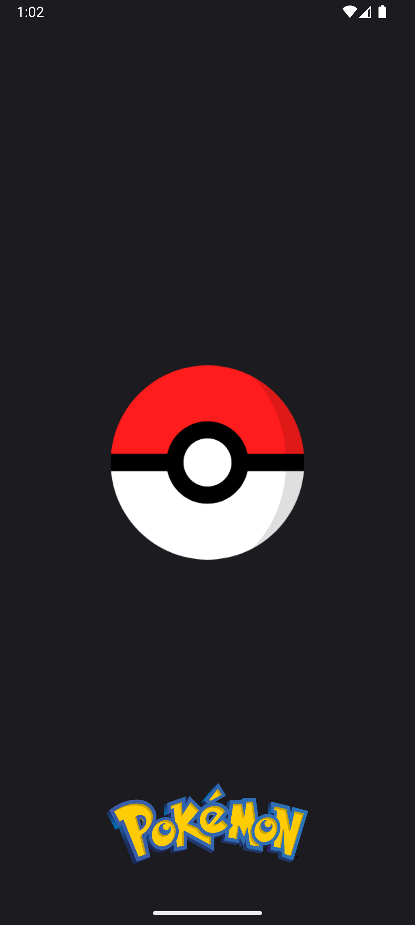
Table of Contents
01
02
Introduction
Architecture
Overview, goals and motivation behind the application project.
UI components, design patterns and external dependencies.
03
04
Demonstration
Conclusion
Showcase the application functionality through animated content.
Planned features, potential future changes and other considerations.
Notes:
Here is an overview of what we will discuss for the next few minutes. There are approximately 2-3 slides for each category, so hopefully, it shouldn't take much of your time.
We have:
Background and motivation
Architectural diagram
Animated demonstration
Deliverables and discussion

Slide 3
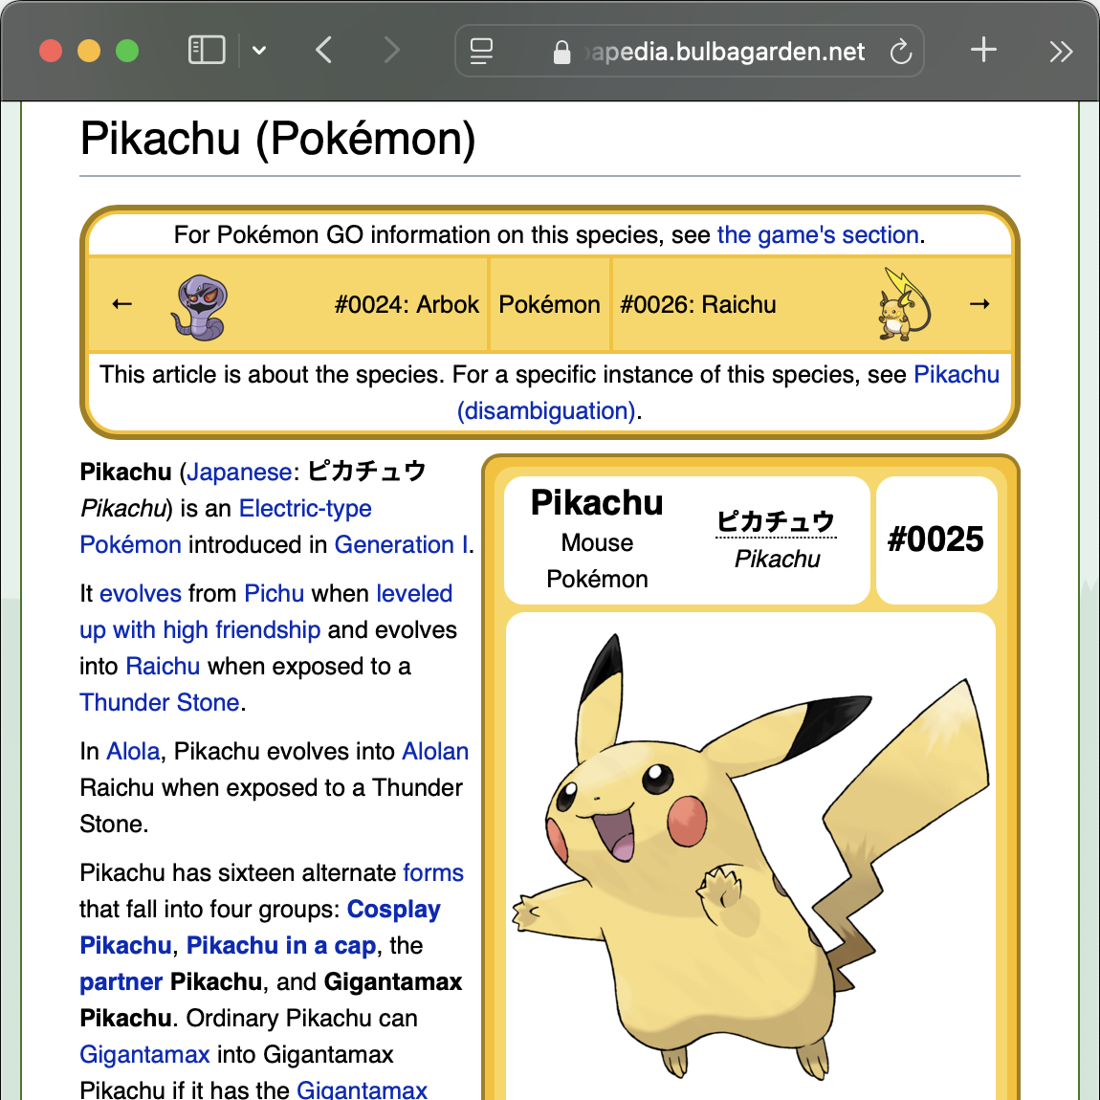
Introduction: Background
Why Pokémon?
What’s different?
Pokémon is a global brand with a huge fanbase.
Handheld access to Pokédex information.
The playful design of a game-themed application is effective for practice.
Ability to save and manage a roster of 6 Pokémon.
The PokeAPI is completely free without a rate limit.
Notes:
This topic resonates with me because the first generation of Pokémon is my first gaming device.
It was Nintendo GameBoy with a Pokémon Red cartridge.
I also think it could be a good practice to make a game-related app since the UI needs to be creative. Finally, PokeAPI is free without a subscription and rate limit, so I don't have to manage session tokens or API keys.
The idea is not new.
Websites and apps about Pokémon are abundant. Bulbapedia, shown here, is a personal favorite. However, most of them are static and don't have a team-building feature.
When I play Pokémon games, I always keep track of technical and hidden machines that my Pokémon can learn.

Slide 4
Introduction: Features
Search
Roster
Battle
Fetch data from PokéAPI
Save to local SQLite
Simulate damage points
Display paginated result of Pokémon information such as:
User roster configurations are persisted internally for future consumption:
Select a member and an opponent to measure damage points a move can inflict.
Base status
Evolution chain
Skill moves
Member name and order
Moves learned
Not a full simulation
Predicts required total steps to defeat an enemy.
Notes:
Here are the main features the app is targeting.
Using data from PokeAPI, users can browse details about monsters and moves.
These data are then passed to a local database when users enroll a Pokémon to the roster.
With a roster, users can predict how many steps are needed to take down a selected enemy with the current skillset in a battle simulation.

Slide 5
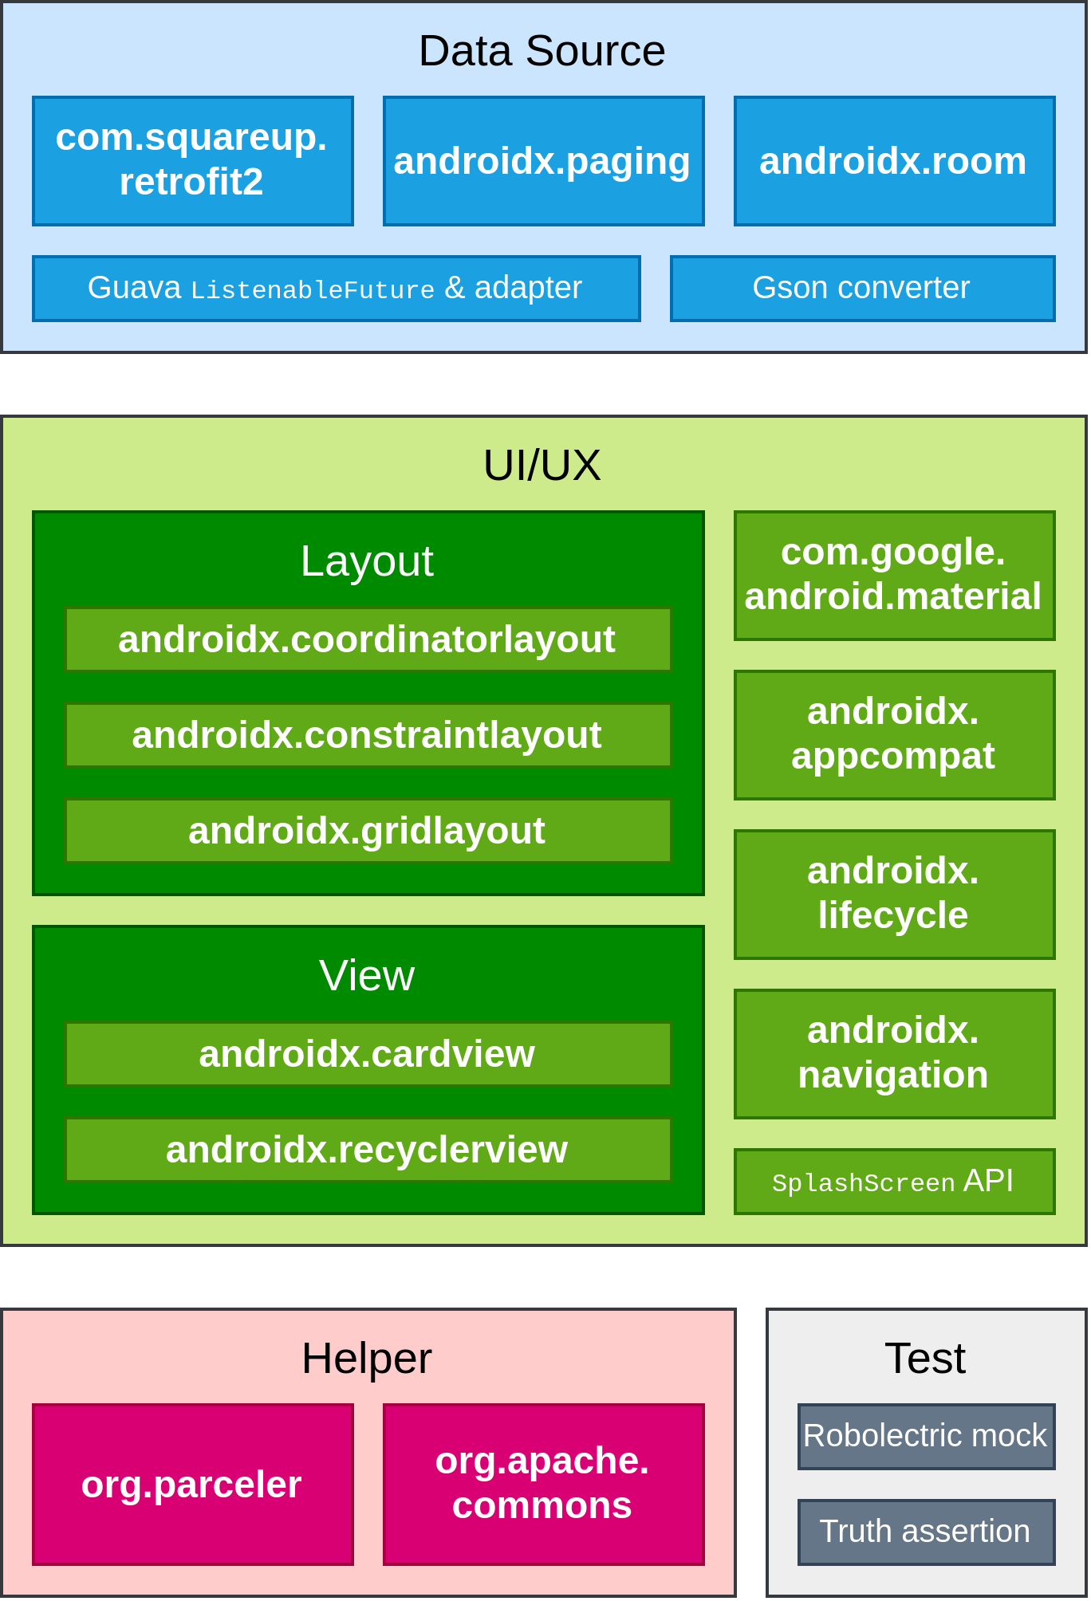
Architecture: Dependencies
Notes:
This application conforms to the Material3 design language and Jetpack Compose principles. At the data handling section, we have Retrofit to make REST API calls and the Room persistence layer to generate SQLite Data Access Object. These objects are preferred because hardcoded SQLite strings are unintuitive and may have typos.
Next, we have standard views and layouts in the UI section. Material and AppCompat libraries provide a set of reusable styles. A notable entry in this group is the Navigation framework for defining component destinations in an XML file.
In the final section, Parceler is a helper tool for converting existing Plain Old Java objects into parcelable objects. Parcelable is more efficient than Java Serializable object when passing values between activities. Robolectric creates mocked objects in the unit tests to reduce testing and building time.

Slide 6
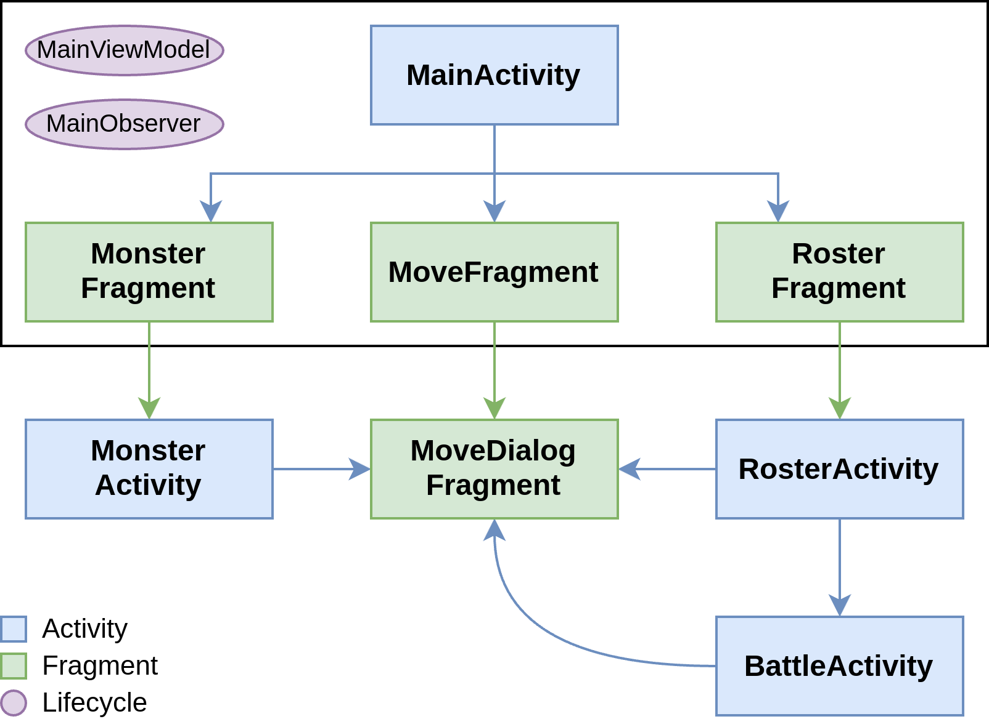


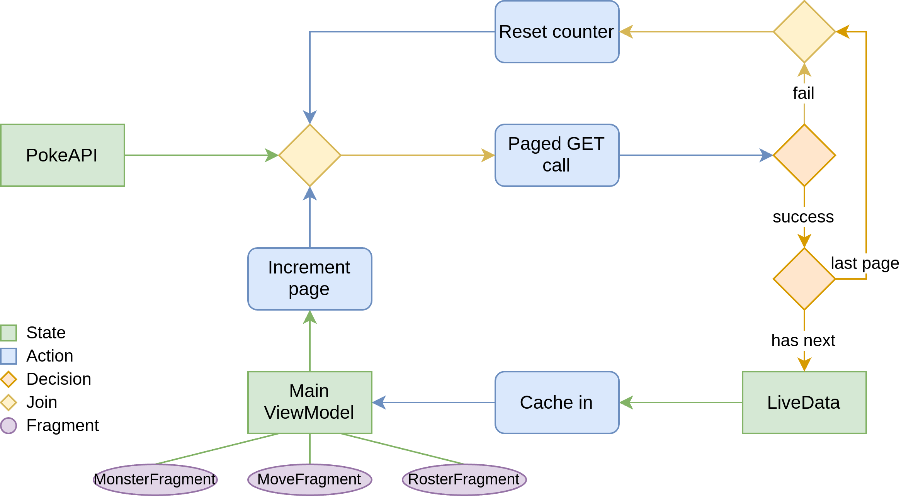
Architecture: Flowchart
Navigation
Data Flow
Notes:
The first chart denotes the application workflow. The main activity consists of three fragments with access to the view model integrated into the Android lifecycle. Each fragment has a different activity destination, but the bottom sheet dialog showing a skill move is accessible from all of them. The lifecycle observer component is useful for starting another activity without a result code and lets us handle the result outside the caller activity.
The diagram below depicts how a client device processes data from the PokeAPI server. The application retrieves information in a certain size and location using GET queries. When a page is successfully loaded, the result is stored in the view model before the pager continues to the next page, creating an endless scrolling behavior. The pager resets itself in the event of a network error or manual refresh by pulling down the list.

Slide 7
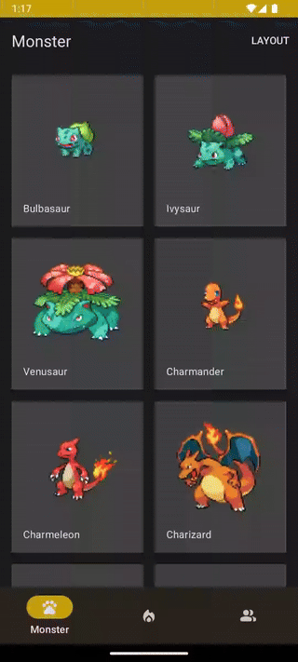
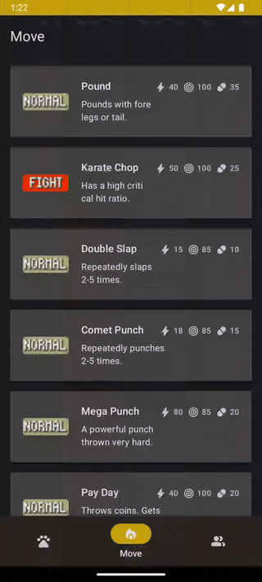
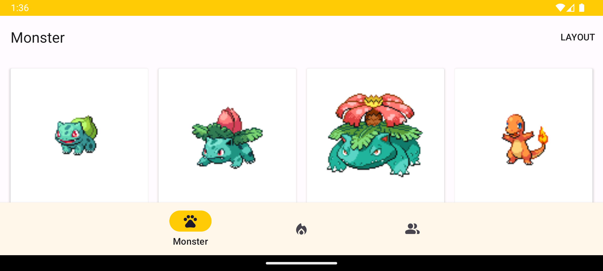
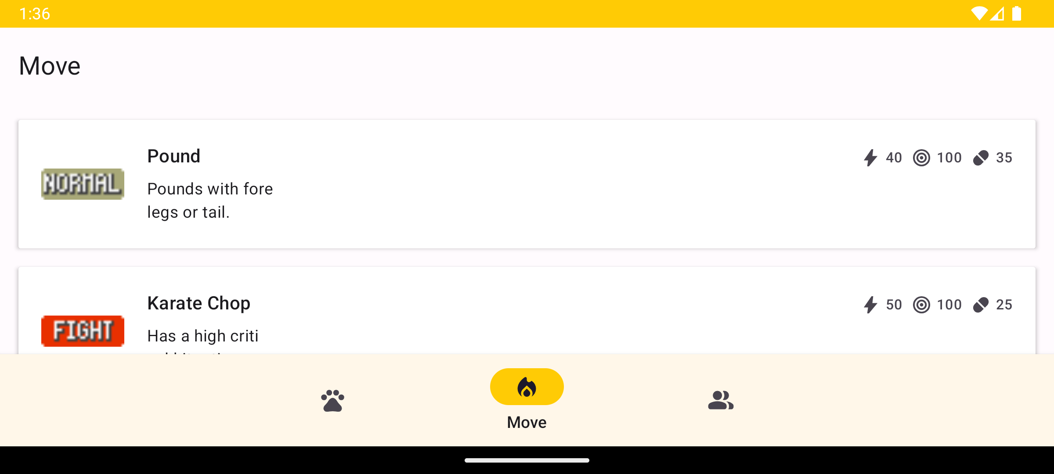
Demonstration: Main Activity
Notes:
You will see horizontal screenshots of the application in a light theme state in the left area. The rest are screen recordings in dark mode. I believe an application should not force a specific configuration like portrait mode and let users decide which settings work best for them.
The monster list loads 20 items per page, while the move list only has 10. Monsters require more items since the card container is stretchable to a mini size by selecting a menu item. Many of the item layouts here are reused later in other activities.

Slide 8
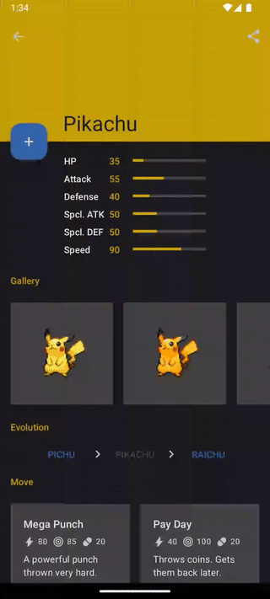
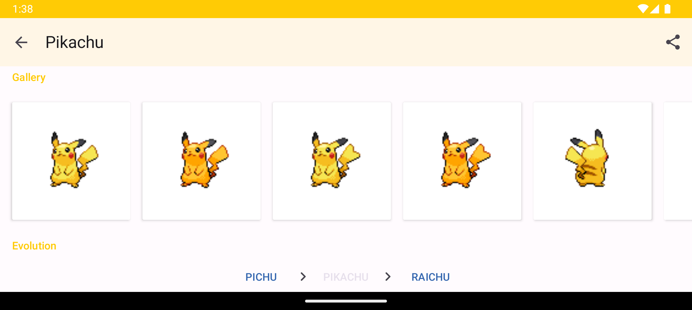
Demonstration: Monster Activity
Notes:
Tapping into a Pokémon card will redirect users into a monster activity. The monster base status is compared against the corresponding max status of non-legendary Pokémon to produce percentages shown below the toolbar. A Pokémon may have separate sprites for female and shiny variants in the horizontal gallery list.

Slide 9
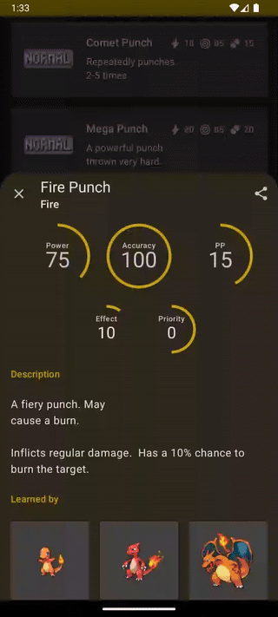
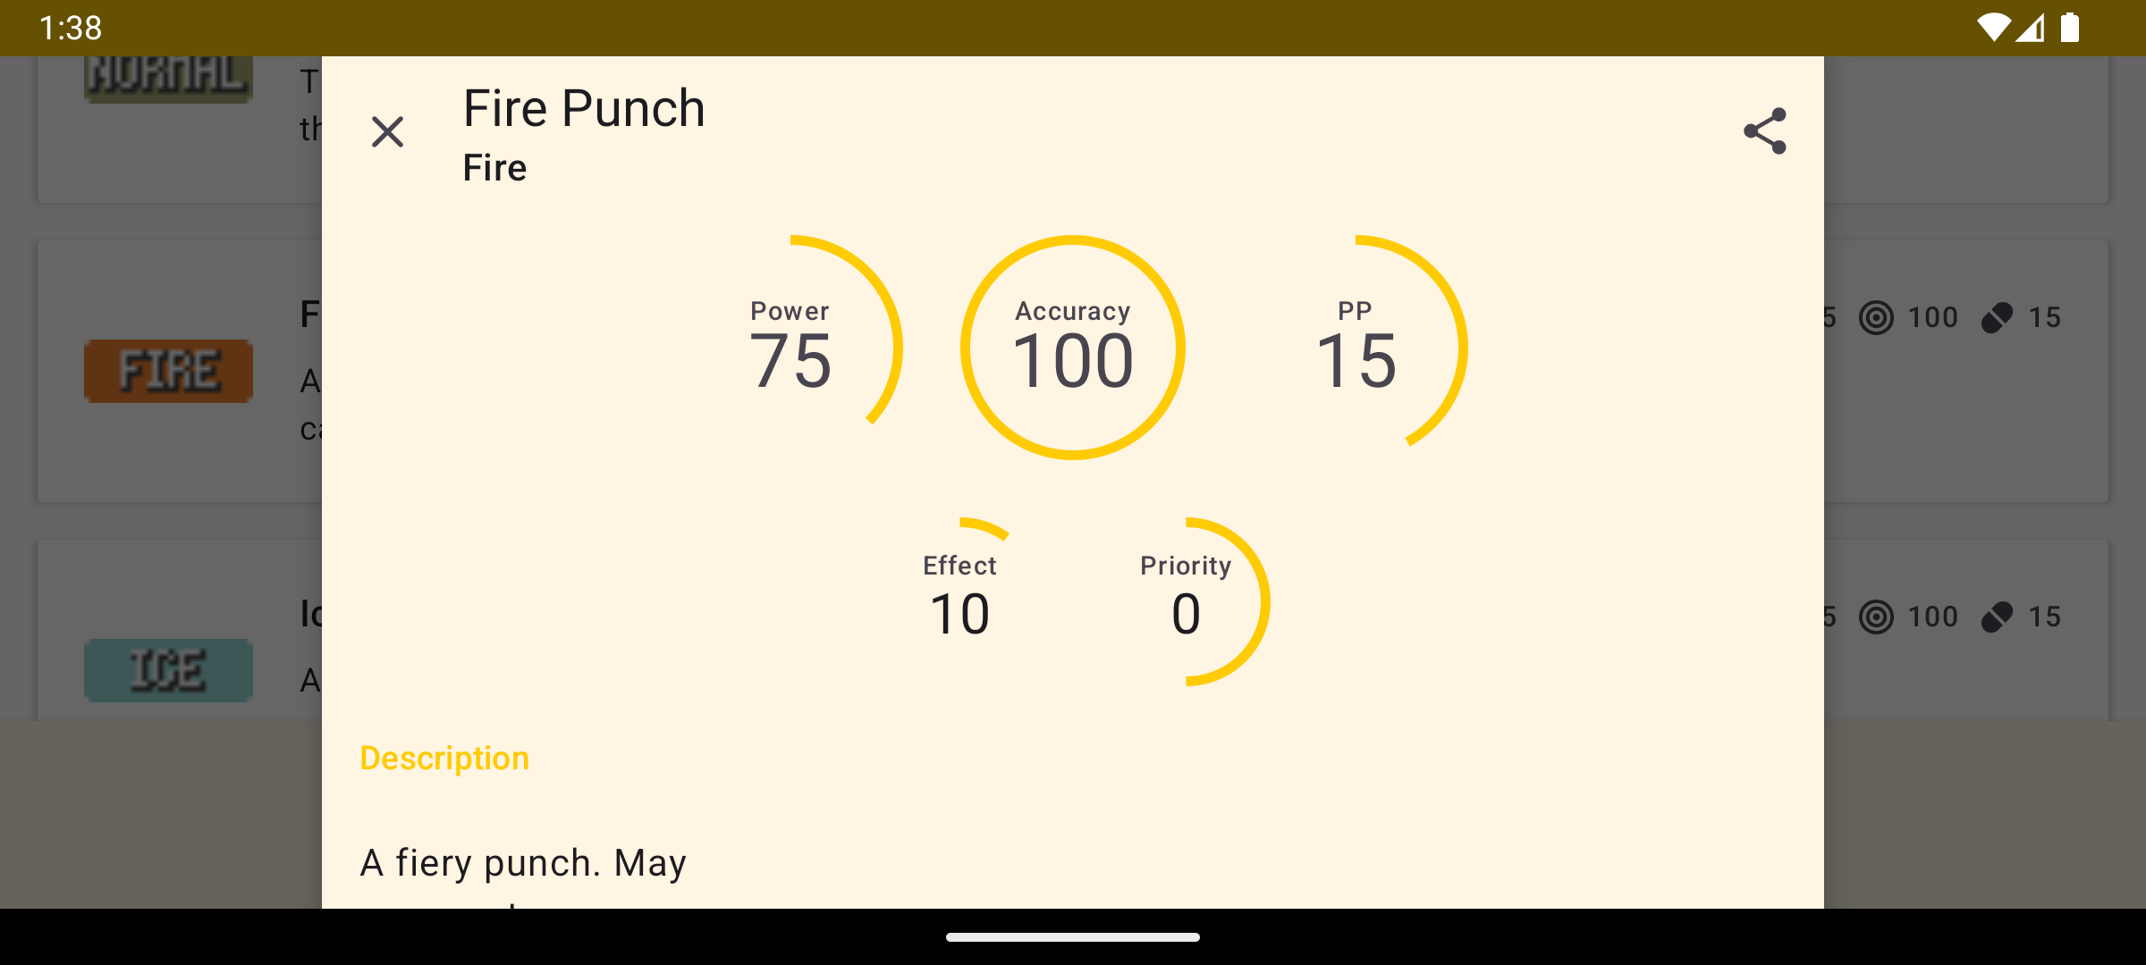
Demonstration: Move Activity
Notes:
A bottom sheet dialog presents the details of skill moves such as power, description and list of trainable Pokémon. This dialog needs to be attached to a fragment manager to retain itself in a configuration change. The bottom sheet will take full screen if the content is scrolled but will stretch itself down in a landscape.

Slide 10

Summary: Challenges
01
04
Limited documentation
Misleading information
Examples and tutorials are scarce because the Jetpack Compose library group is fairly new.
The application currently has no strategy to distinguish between different generations of Pokémon games.
02
03
Android is abandoning Java
Repetitive HTTP calls
Although the Android base is still Java, AndroidX core libraries are being rewritten in Kotlin.
Most list items require more than one call, increasing the possibility of failure.
Notes:
I faced several challenges during development. From a technical standpoint, there are limited resources online because Jetpack Compose is relatively new.
Google declared Kotlin as the official language of Android in 2019 and has since aggressively rewritten AndroidX and Material libraries in Kotlin to a point where it's unavoidable. For example, the Paging API performs background calls in Kotlin coroutines instead of Java Thread or Android AsyncTask.
The application is also not very efficient and vulnerable to network failure due to the large number of requests it is requesting from the server. For instance, the paged REST API call result only returns the name of Pokémon, requiring the app to send a subsequent call to collect the entire information. Unfortunately, this problem is unfixable as I have no control over the server and its API blueprint.
Lastly, the app cannot determine which generation the information belong to. It is not a technical challenge, but rather, a design decision I have not made.

Slide 11
Summary: Roadmap
01
Phase 1
Establish the project idea and provide wireframe illustrations.
Progress 1
02
Implement REST API caller and pagination, enabling monsters and move features.
03
Progress 2
Implement SQLite database and activity registry, enabling roster feature.
Progress 3
04
Reuse the code as much as possible with abstraction, reducing the overall size and complexity.
05
Phase 2
Capture screen recording and create this presentation.
Future progress
06
This milestone is dedicated to supporting the missing feature battle simulation.
07
End
Package the final product and produce technical documentation for submission.
Notes:
The PokémonRoster project is established during the submission of phase 1, using the wireframe as UI guidelines.
Initially, the development started with bridging a connection between client and server necessary for monster and move features.
With a list of monsters available, I then focused on storing them in a local database for the roster feature.
In the most recent progress, the majority of the codebase is modularized to maintain a low footprint.
Then, we are here at phase 2.
I acknowledge that some parts of the application are still missing, namely the battle simulation feature.
I intend to finish the requirements before final submission, along with documentation related to the development.

Slide 12


Thank You
for your time and attention
Notes:
Thanks for joining me today! I hope you found it interesting. I have learned a lot from the development progress. I conclude this presentation by taking any questions about the app. If there isn't any, I wish everyone a warm Thanksgiving. *Disclaimer: I do not own this PowerPoint template, the creator is attributed at the top of the page.

